Slide 1


Implementing a Secure Multi-Branch Office Network
Digital Egypt Pioneers Initiative
Final Project

Slide 2
Team Members
Moahmed Nasser Mohamed Elshamy
Mohamed Moomen Abd El Hamid
Hazem Ahmed Saad Abdel Aziz
Imad Abdel Hamid Ali Attia
Moustafa Hossam Hassien
Mohamed Hosny Mohamed

Slide 3



Content
Access Layer
Firewall
VPN
Tests
8
Project
Diagram
1
3
5
7
Distribution Layer
SD-WAN
Sec Branch

Slide 4
1
Project Diagram

Slide 5
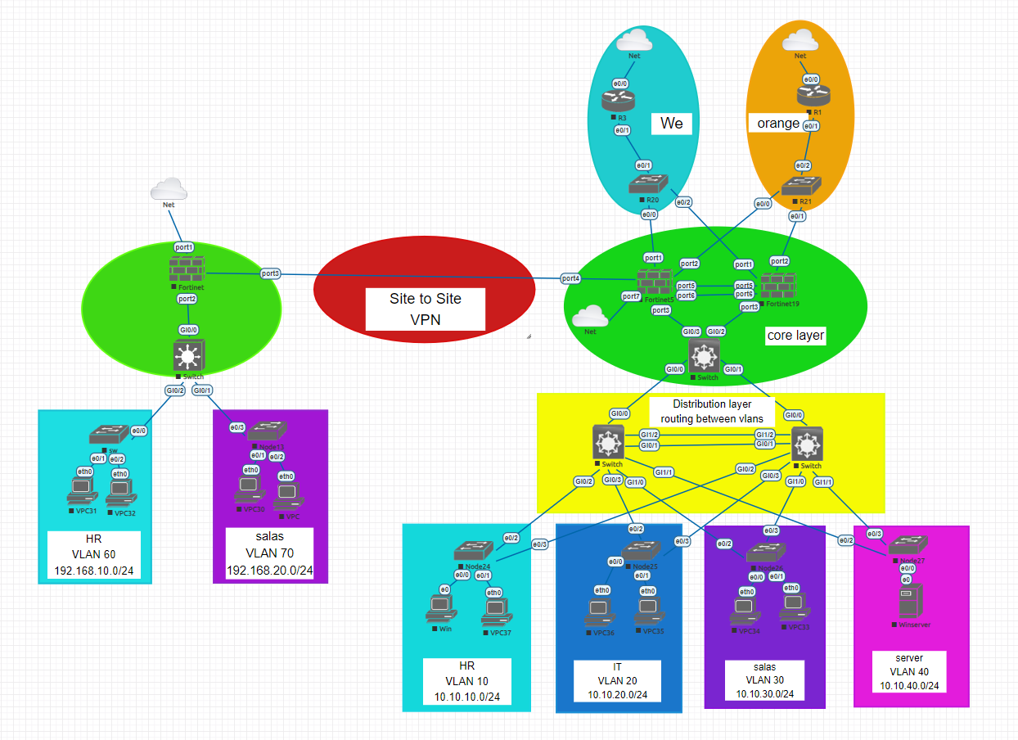

Slide 6
2
Access layer

Slide 7
Access Layer
The access layer grants end devices access to the network. In the WAN environment, it may provide teleworkers or remote sites access to the corporate network across WAN connections.
Generally incorporates Layer 2 switches and access points providing connectivity and serves
a number of functions including:
Layer 2 switching
High availability
Port security
Address Resolution Protocol (ARP) inspection
Rapid PVST
Basic setting ( SSH - ACL for ssh )

Slide 8
configuration
All access switch
En
Conf t
Hostname access –sw
Username cisco password cisco
Enable password cisco
Banner motd & no unathorised access &
No ip domin-lookup
Service password-encryption
Line console 0
Password cisco
Login local
Exec-timeout 00
Logging synchronous
Exit
Ip domin-name cisco.com
Crypto key generate rsa general key modalus 1024
Ip ssh version 2
Line vty 0 15
Login local
Transport input ssh
Exit
Access-list 1 permit 192.168.30.0 0.0.0.255
Access-list 1 deny any
Line vty 0 15
Access-class 1 in
Exit

Slide 9
configuration
All access switch
en
Conf t
Int range e0/2-3
Switchport trunk encapsulation dot1Q
Switchport mode trunk
Switchport nonegotiation
Exit
Vtp domin cisco.com
Vtp password 123
Vtp version 3
Vtp mode client
Do show vlan
Spanning-tree mode rapid-pvst
Spanning-tree vlan1,10,20,30,40
Ip dhcp snooping vlan 1,10,20,30,40
Int e0/0-1
Switchport mode access
Switchport access vlan 10
Spanning-tree portfast
Spanning-tree Bpdugard enable
Switchport portsecurity
Switchport portsecurity max 1
Switchport portsecurity mac-address stacky
Switchport portsecurity violation shutdown
Ip dhcp snooping l imit-rate 4
Int range e0/2-3
Ip dhcp snooping trust
Exit
Errdisable recovery interval 30
Errdisable recovery cuase portsecurity

Slide 10
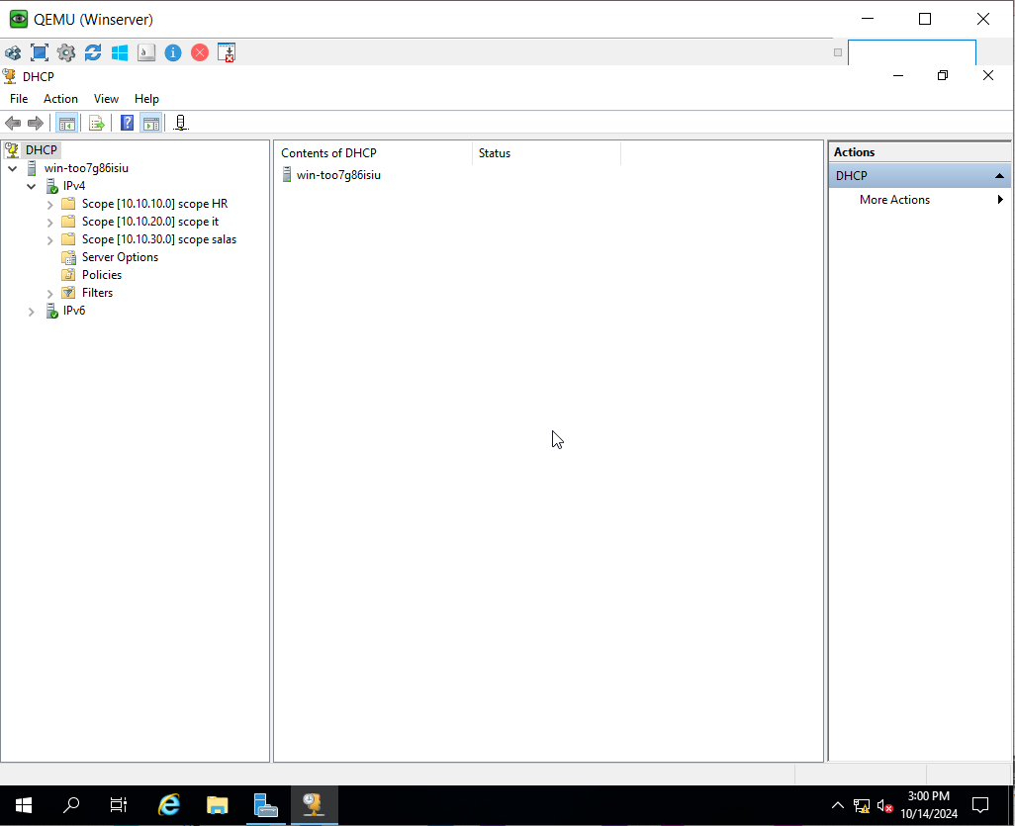
configuration
Windows server (DHCP)

Slide 11
3
Distribution Layer

Slide 12
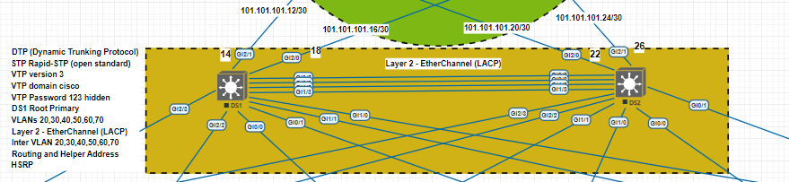
Distribution Layer
The distribution layer is the boundary between the Layer 2 and the Layer 3 routed network.
Layer 2 ether-channel.
Routing services between LANs and VLANs and between routing domains.
Redundancy.

Slide 13
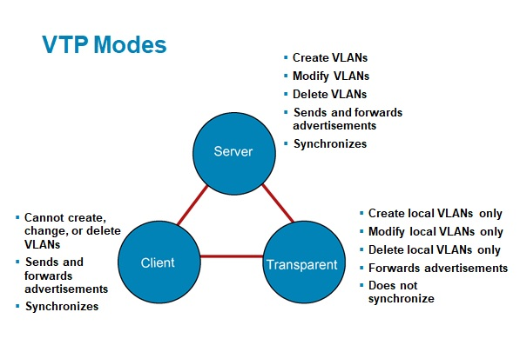
Distribution Layer
VTP ( VLAN Trunnking Protocol ):
What’s VTP ?
What’s VTP V3?

Slide 14
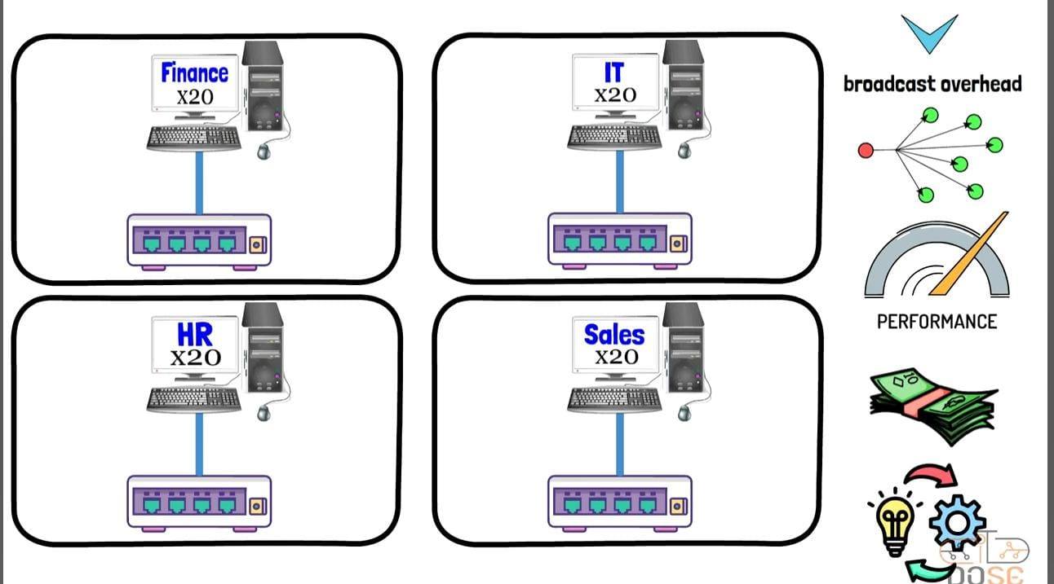
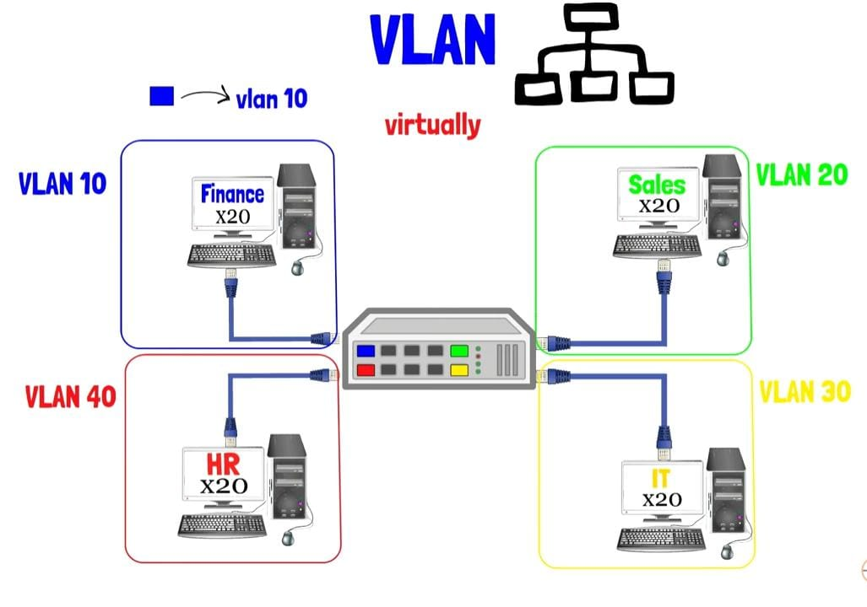
VLANs (Virtual Local Area Network):
What’s VLAN?
Advantages of a VLAN:
Separate broadcast domain.
Decrease broadcast domain.
Enhance network performance.
Scalable.
More security.

Slide 15
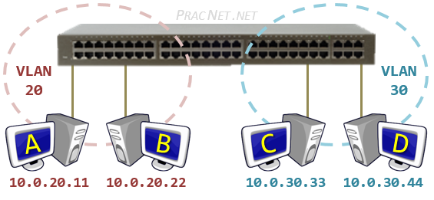
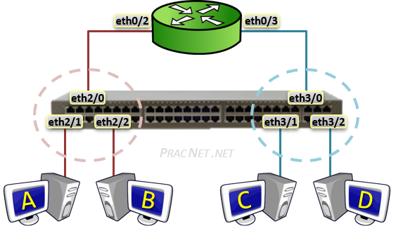
Routing Between VLANs
Why do we need Routing
Between VLANs?
There are three options available to
enable routing between the VLANs:
Router with a Separate Physical Interface in each VLAN
Router with a Sub-Interface in each VLAN
Using a Layer 3 Switch ( Best method )
Router with a Separate Physical Interface in each VLAN ( Traditional Method)

Slide 16
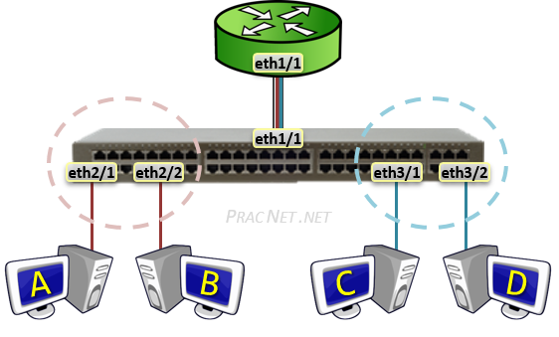
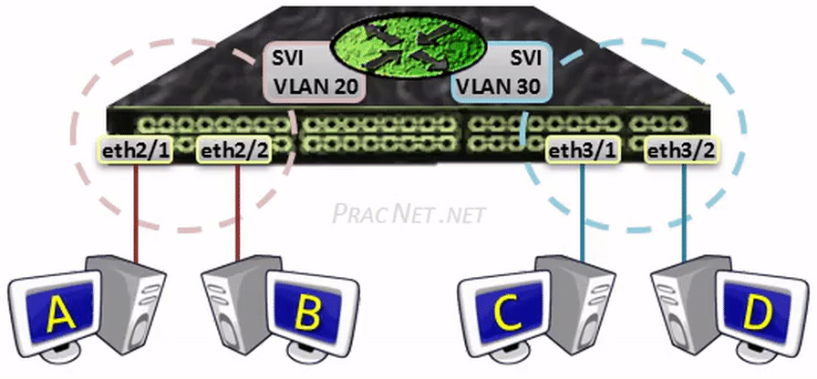
Router with a Sub-Interface in each VLAN ( Router on a Stick )
A Sub-Interface allows a single Physical interface
to be split up into multiple virtual sub-interfaces,
each of which terminate their own VLAN.
Layer 3 Switch ( Best method )
You have the option of configuring an IP address within what is known as an SVI ( Switched Virtual Interface )
The configuration for an SVI involves two parts. First, enabling IP Routing; and Second, applying an IP address
to the VLAN.
This IP will be the default gateway for the VLAN.

Slide 17
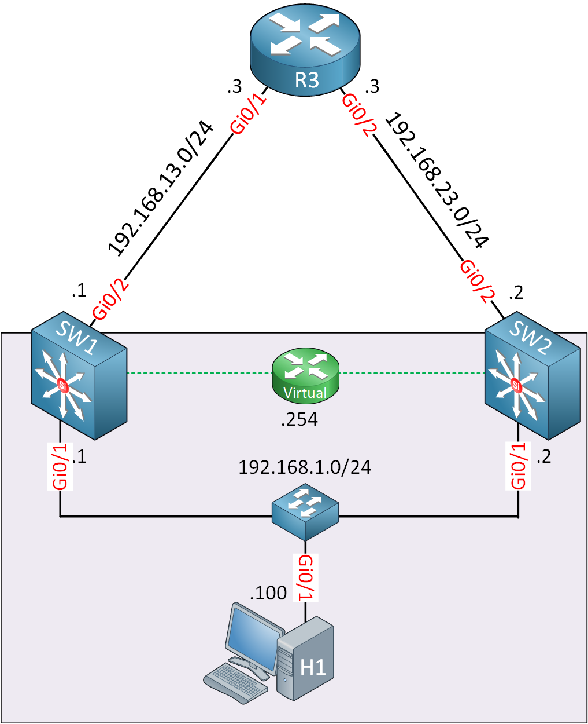
VRRP
What’s VRRP?
Active
Standby
Virtual gateway

Slide 18
configuration
Distribution swihch
en
conf t
hostname core-sw2
username cisco password cisco
banner motd & no unathorised access &
enable password cisco
service password-en
no ip domain-lookup
line console 0
login local
exec-timeout 00
logging syn
exit
ip domain-name cisco.com
crypto key generate rsa general-keys modulus 1024
ip ssh version 2
line vty 0 15
transport input ssh
Exit
Access-list 1 permit 192.168.30.0 0.0.0.255
Access-list 1 deny any
Line vty 0 15
Access-class 1 in
Exit

Slide 19
configuration
Distribution swihch
en
conf t
vtp domain cisco.com
vtp password 123
vtp version 3
vlan 10
name HR
vlan 20
name it
vlan 30
name salas
vlan 40
name server
Exit
spanning-tree mode rapid-pvst
spanning-tree vlan 1,10,20,30,40 priority 24576
interface GigabitEthernet0/0
no switchport
ip address 10.10.50.2 255.255.255.0
negotiation auto
vrrp 50 ip 10.10.50.4
vrrp 50 priority 150
vrrp 50 authentication text cisco
vrrp 50 track 1 decrement 60
interface GigabitEthernet0/1
switchport trunk encapsulation dot1q
switchport mode trunk
switchport nonegotiate
negotiation auto

Slide 20
configuration
Distribution swihch
interface GigabitEthernet0/1
switchport trunk encapsulation dot1q
switchport mode trunk
switchport nonegotiate
negotiation auto
!
interface GigabitEthernet0/2
switchport trunk encapsulation dot1q
switchport mode trunk
switchport nonegotiate
negotiation auto
!
interface GigabitEthernet0/3
switchport trunk encapsulation dot1q
switchport mode trunk
switchport nonegotiate
negotiation auto
interface GigabitEthernet1/0
switchport trunk encapsulation dot1q
switchport mode trunk
switchport nonegotiate
negotiation auto
!
interface GigabitEthernet1/1
switchport trunk encapsulation dot1q
switchport mode trunk
switchport nonegotiate
negotiation auto
!
interface GigabitEthernet1/2
no switchport
ip address 10.10.60.1 255.255.255.0
negotiation auto
!

Slide 21
configuration
Distribution swihch
interface Vlan10
ip address 10.10.10.2 255.255.255.0
ip helper-address 10.10.40.4
vrrp 10 ip 10.10.10.1
vrrp 10 priority 150
vrrp 10 authentication text cisco
vrrp 10 track 1 decrement 60
!
interface Vlan20
ip address 10.10.20.2 255.255.255.0
ip helper-address 10.10.40.4
vrrp 20 ip 10.10.20.1
vrrp 20 priority 150
vrrp 20 authentication text cisco
vrrp 20 track 1 decrement 60
!
interface Vlan30
ip address 10.10.30.2 255.255.255.0
ip helper-address 10.10.40.4
vrrp 30 ip 10.10.30.1
vrrp 30 priority 150
vrrp 30 authentication text cisco
vrrp 30 track 1 decrement 60
!
interface Vlan40
ip address 10.10.40.2 255.255.255.0
vrrp 40 ip 10.10.40.1
vrrp 40 priority 150
vrrp 40 authentication text cisco
vrrp 40 track 1 decrement 60
!
ip route 0.0.0.0 0.0.0.0 10.10.50.1

Slide 22
4
Firewall

Slide 23
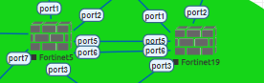
Firewall
A firewall is a network security device or software that monitors and controls incoming and outgoing network traffic based on predetermined security rules
Its primary function is to establish a barrier between trusted internal networks and untrusted external networks, such as the internet, to prevent unauthorized access and potential threats.

Slide 24
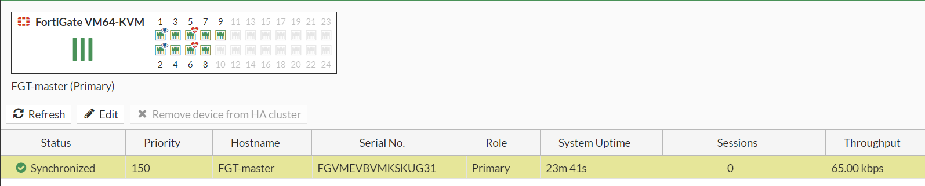
Firewall
High Availability (HA)
High Availability (HA) in FortiGate firewalls provides redundancy by using multiple devices. If one fails, another takes over to ensure continuous service without downtime.

Slide 25
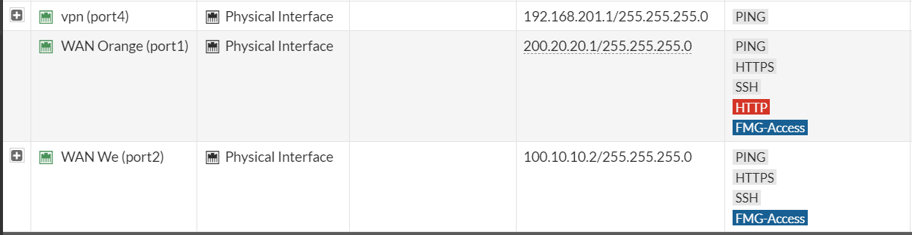
Firewall
Interface ( WAN PORT)

Slide 26
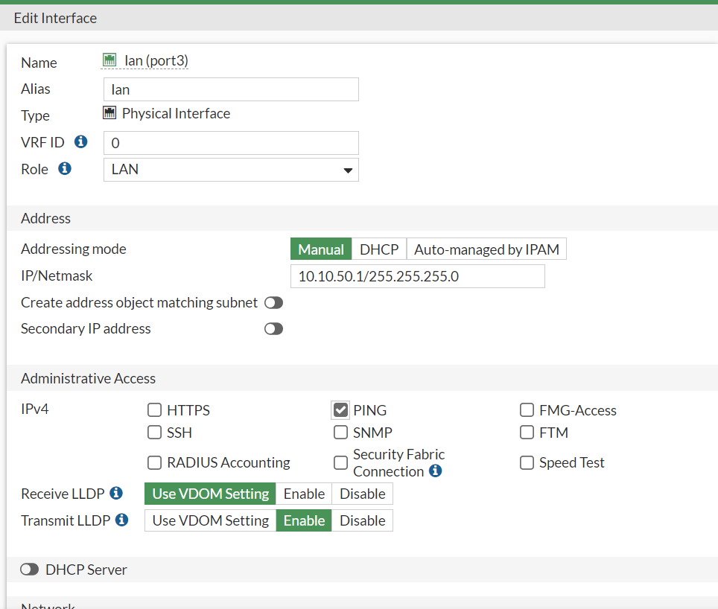
Firewall
Interface ( LAN PORT)

Slide 27
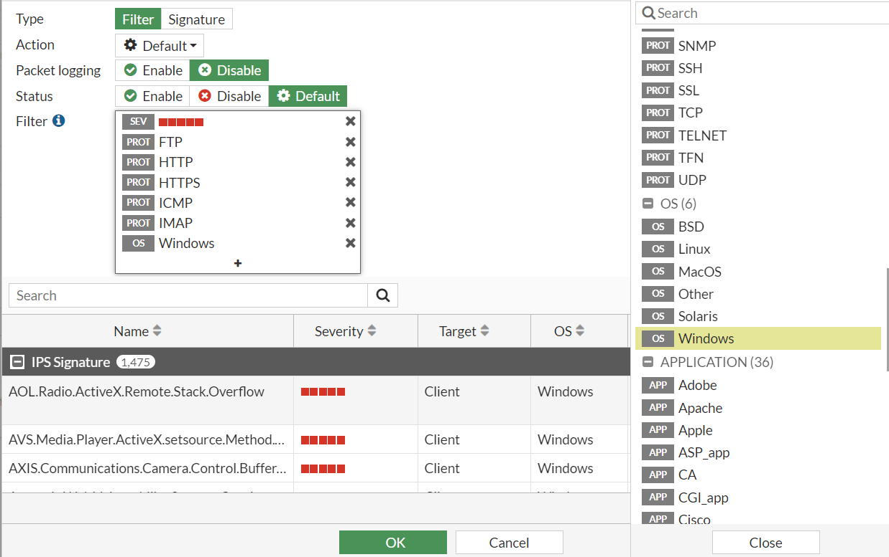
Firewall
Security profile (IPS)
The IPS (Intrusion Prevention System) in FortiGate inspects network traffic for malicious activity and potential threats, such as intrusion attempts or vulnerability exploits. It automatically blocks or alerts on detected threats to protect the network in real time.

Slide 28
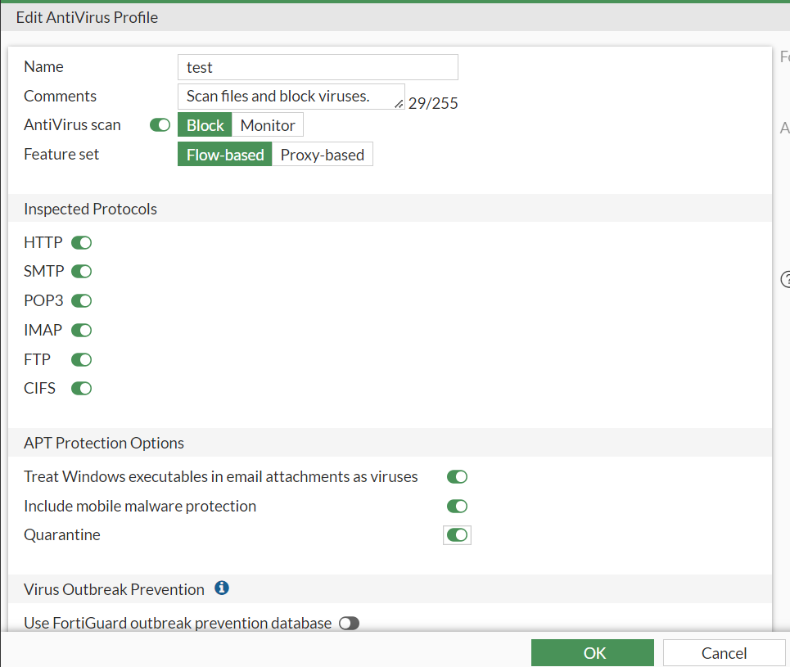
Firewall
Security profile (antivirus)
The antivirus feature in FortiGate scans network traffic and files for viruses, malware, and other malicious content. It prevents infections by detecting and blocking harmful files before they can reach devices on the network.

Slide 29
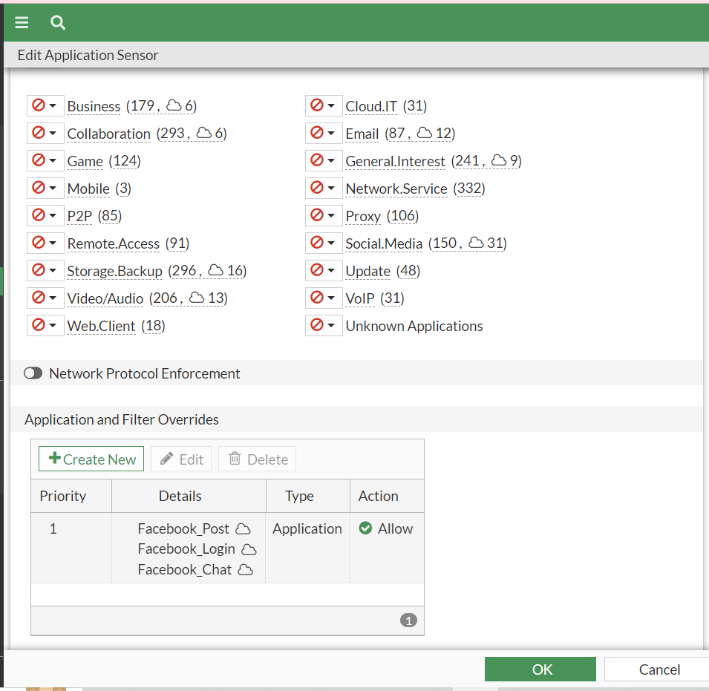
Firewall
Security profile (web filter)
The web filtering feature in FortiGate controls access to websites by categorizing and blocking harmful or inappropriate content. It helps enforce security policies and protect users from malicious sites, phishing, and other online threats.

Slide 30
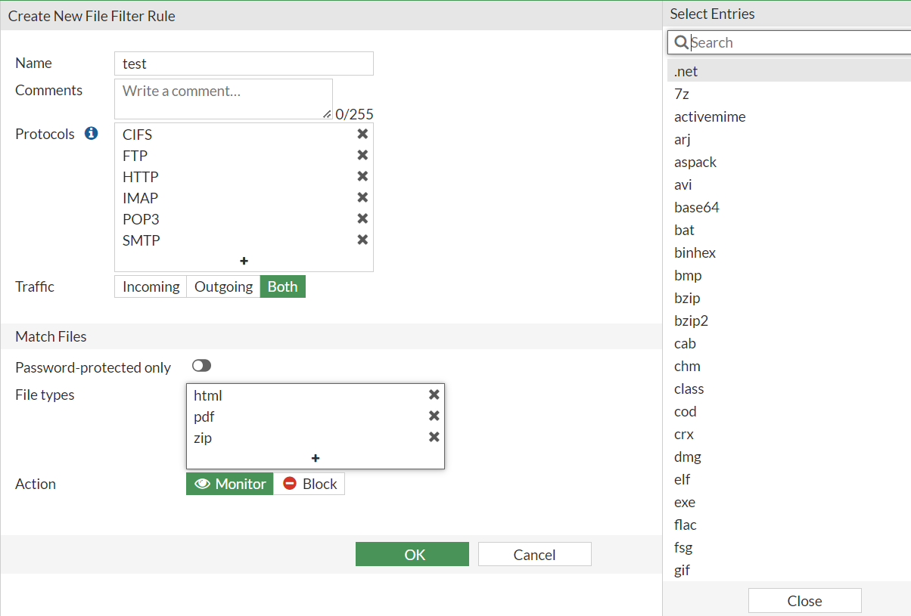
Firewall
Security profile (file filter)
The file filter feature in FortiGate blocks or restricts access to specific file types within network traffic. It helps prevent the transfer of unauthorized or malicious files, enhancing data security and compliance.

Slide 31
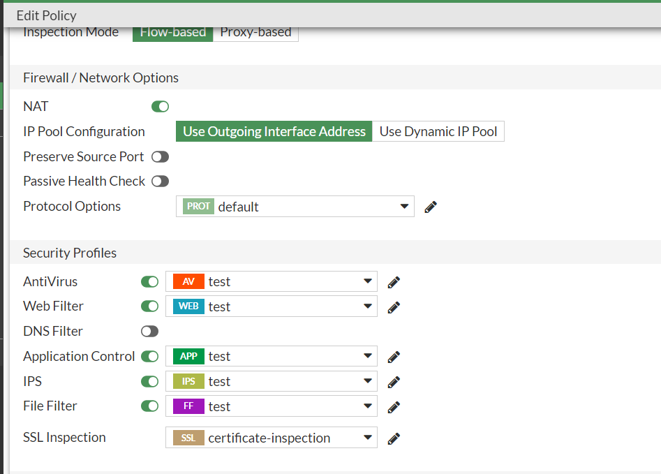
Firewall
Security profile (In policy )

Slide 32
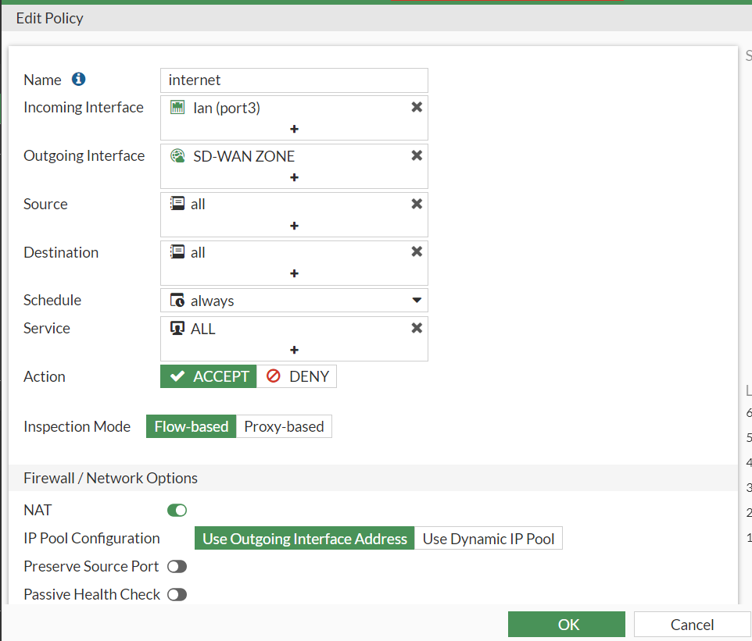
Firewall
Internet policy

Slide 33
5
SD-WAN

Slide 34
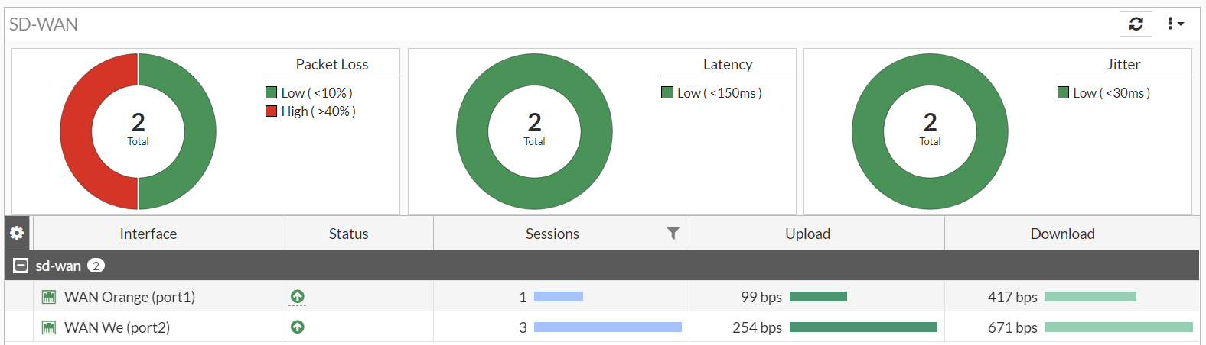
SD-WAN
The SD-WAN feature in FortiGate optimizes and manages multiple WAN connections, improving performance and reliability. It intelligently routes traffic based on application needs, ensuring secure and efficient connectivity across different network paths.

Slide 35
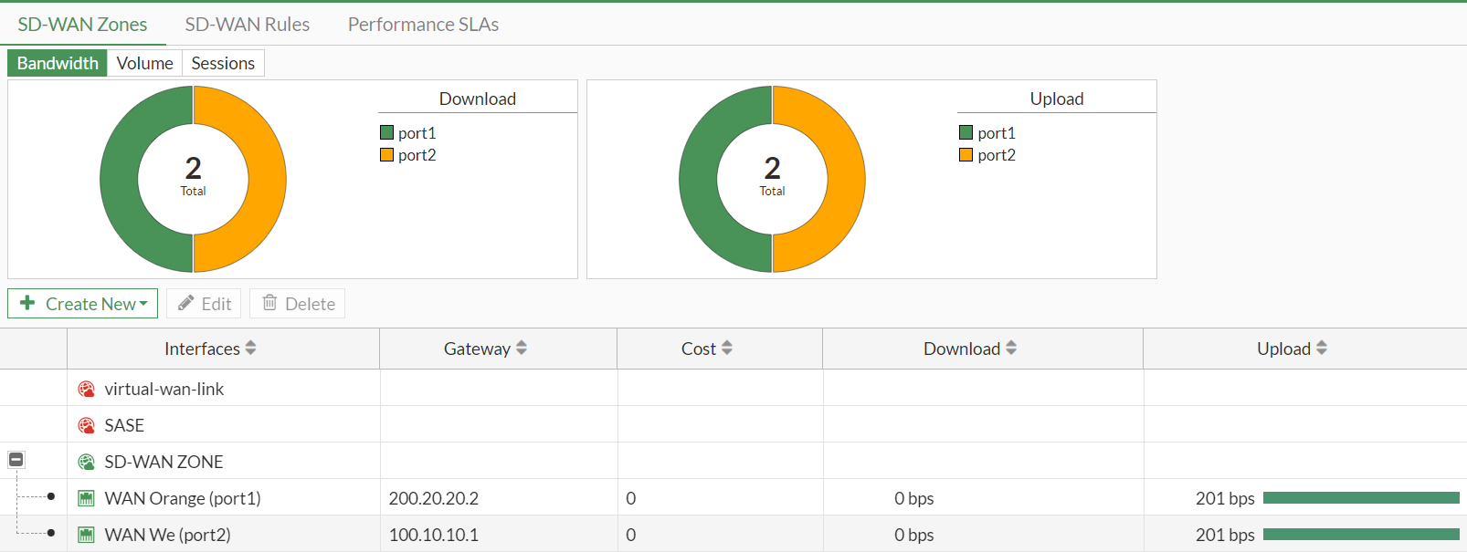
SD-WAN
Sd-wan zone

Slide 36
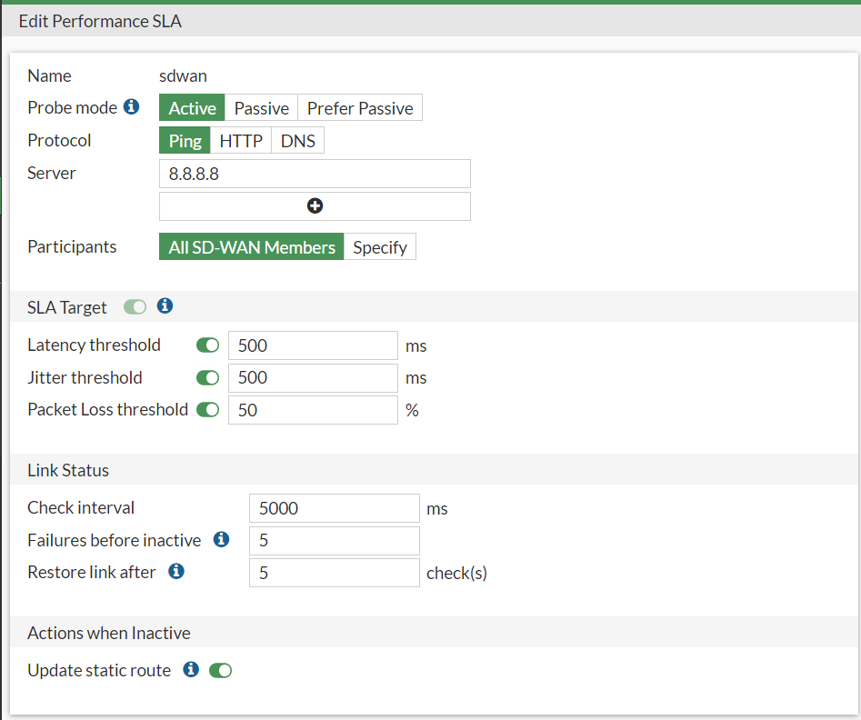
SD-WAN
Sd-wan LSA

Slide 37
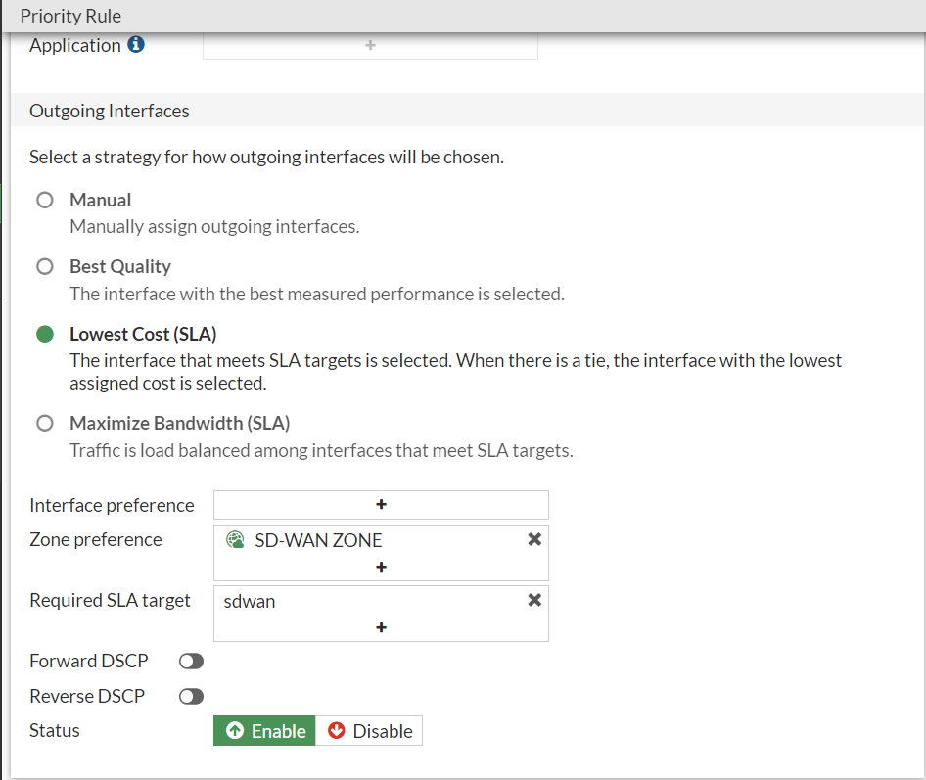
SD-WAN
Sd-wan Role

Slide 38
6
VPN

Slide 39
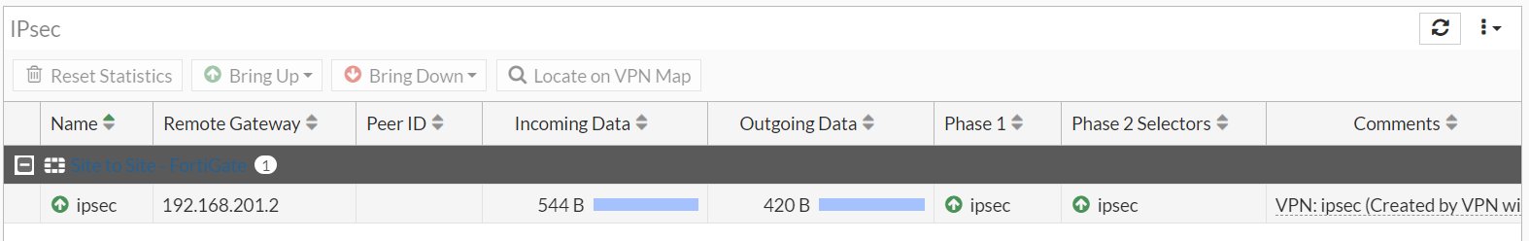
VPN
Site to site vpn
The site-to-site VPN in FortiGate establishes secure, encrypted tunnels between different networks over the internet. It enables seamless communication between remote sites, ensuring data confidentiality and integrity while allowing centralized management and access control.

Slide 40
7
Tests

Slide 41
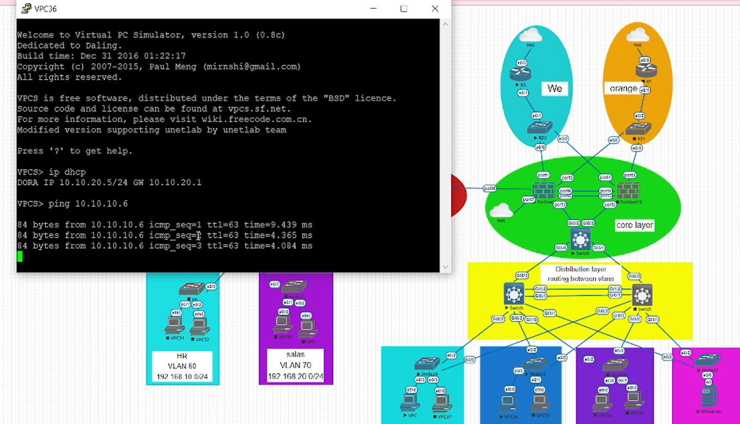
Test
Test routing between vlan

Slide 42
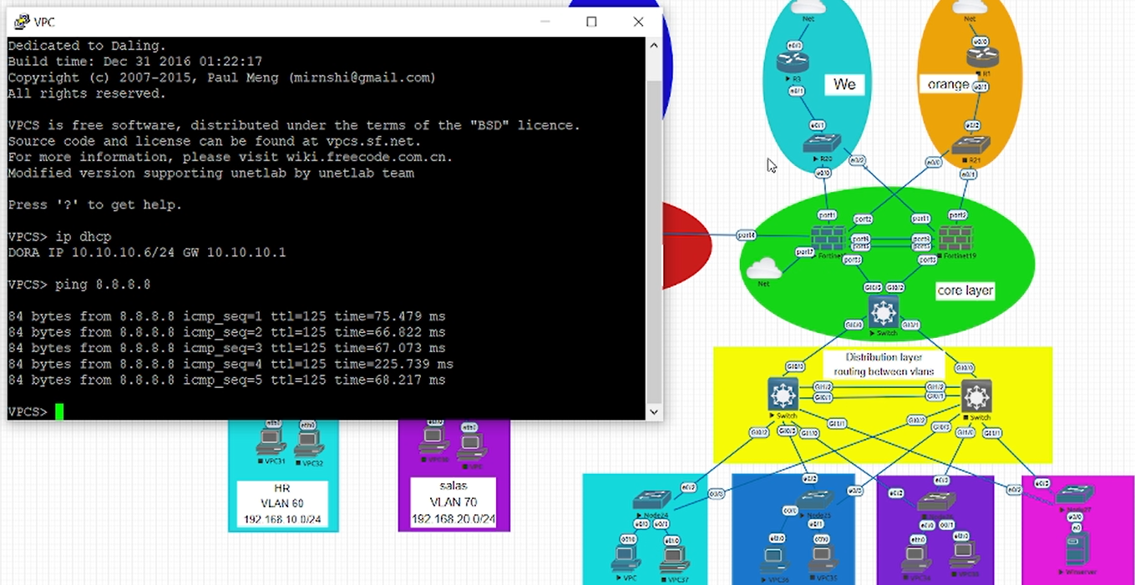
Test
Test internet

Slide 43
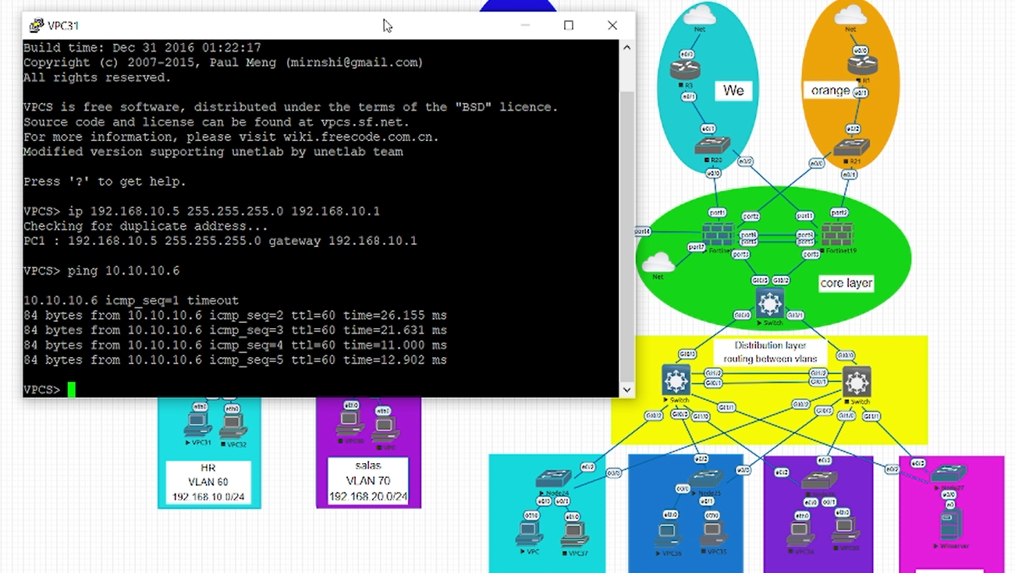
Test
Test conectivity between two sites

Slide 44
Thank You
For your time

